Slide 1


Deep Learning Based Lung Image Segmentation Using XR-U-Net
Sajeeb Kumar Ray, Ariful Islam, Manob Chandra Chanda, Naima Islam, Md. Anwar Hossain, Mirza A.F.M. Rashidul Hasan and Al Amin
2024 27th International Conference on Computer and Information Technology (ICCIT)

Slide 2
Table of Contents
Introduction
Materials
Methods
Results
Discussion

Slide 3
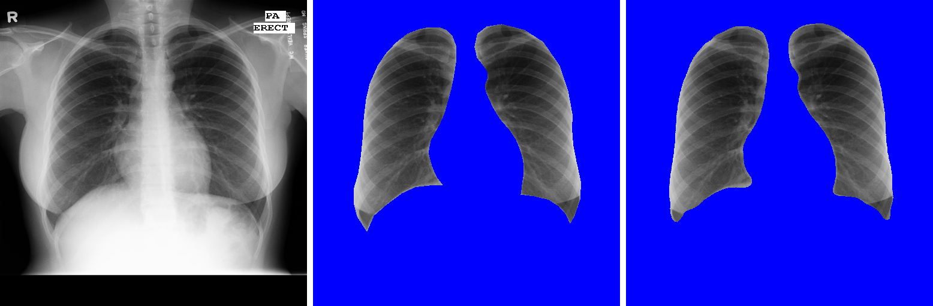
Lung Image Segmentation
Lung image segmentation is the process of separating the lung area from medical images like X-rays or CT scans to help doctors understand and treat lung problems.
Segmentation
Introduction

Slide 4
X-Ray and U-Net
X-ray imaging is widely used and affordable globally.
Chest X-rays crucial for identifying various lung conditions.
Over one-third of medical imaging involves chest X-rays.
U-Net excels in precise segmentation using skip connections.
Introduction

Slide 5
Our Contributions
Designed a XR-U-Net with five-layers of encoder-decoder structure.
Eliminated preprocessing to streamline segmentation workflow.
Conducted visual evaluations of segmented image results.
Introduction

Slide 6
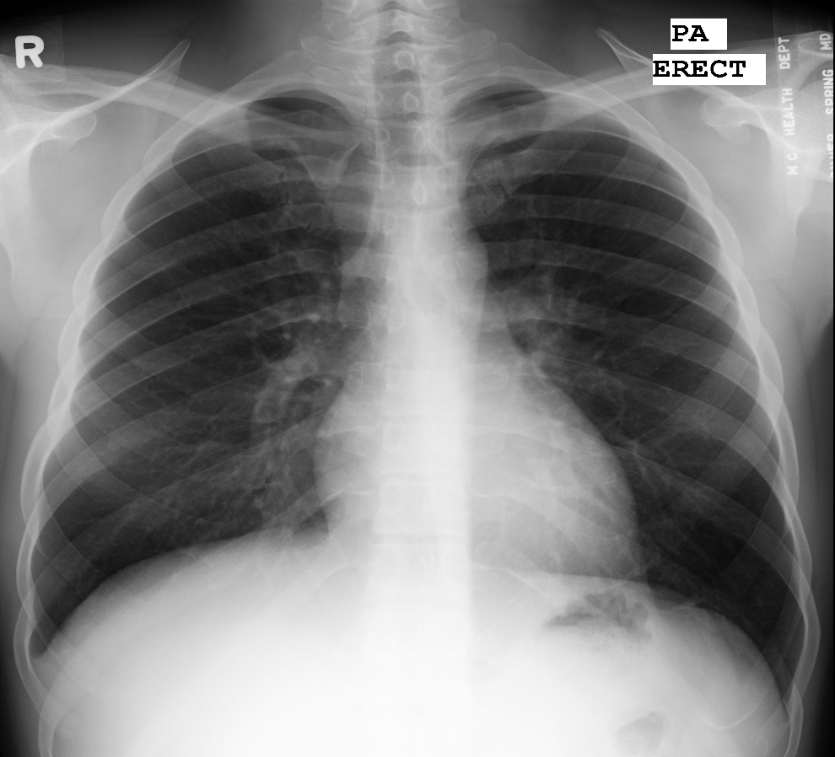
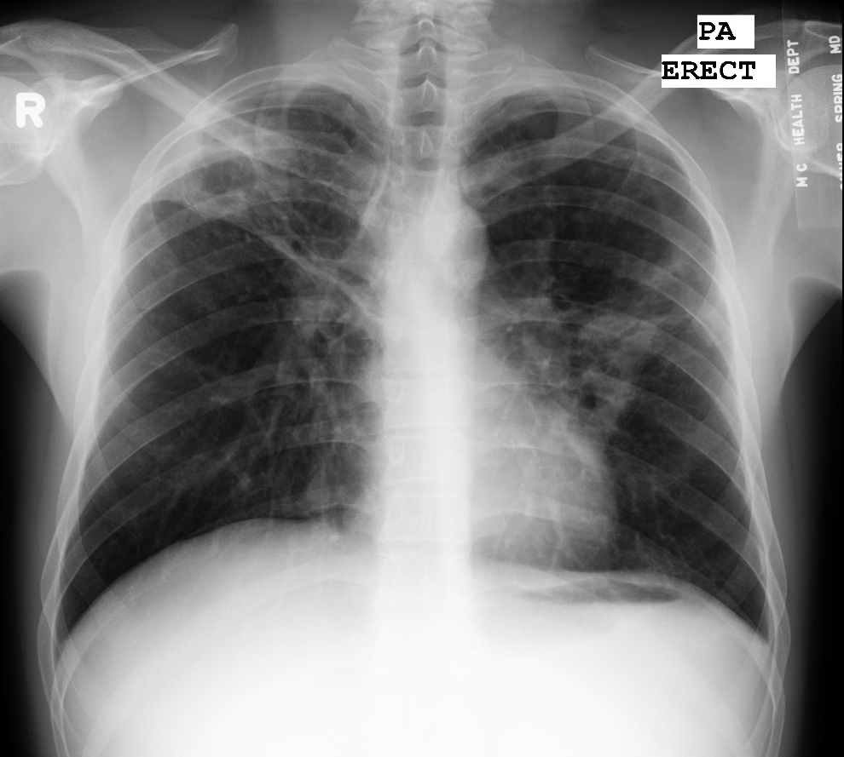
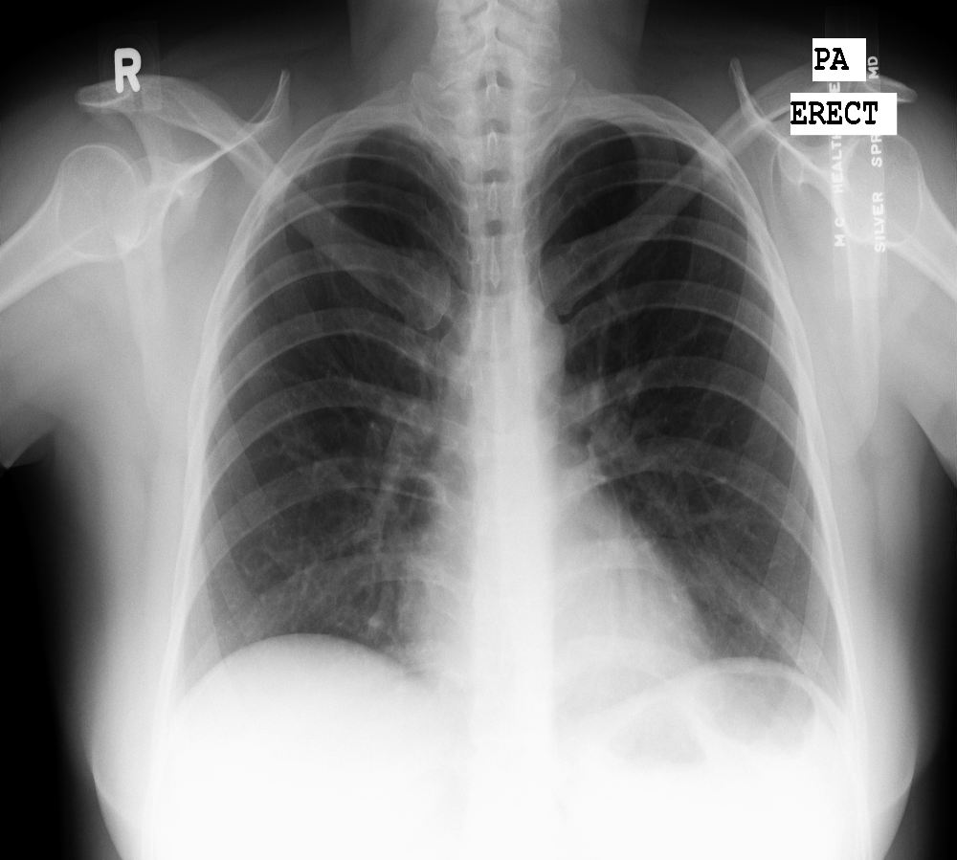
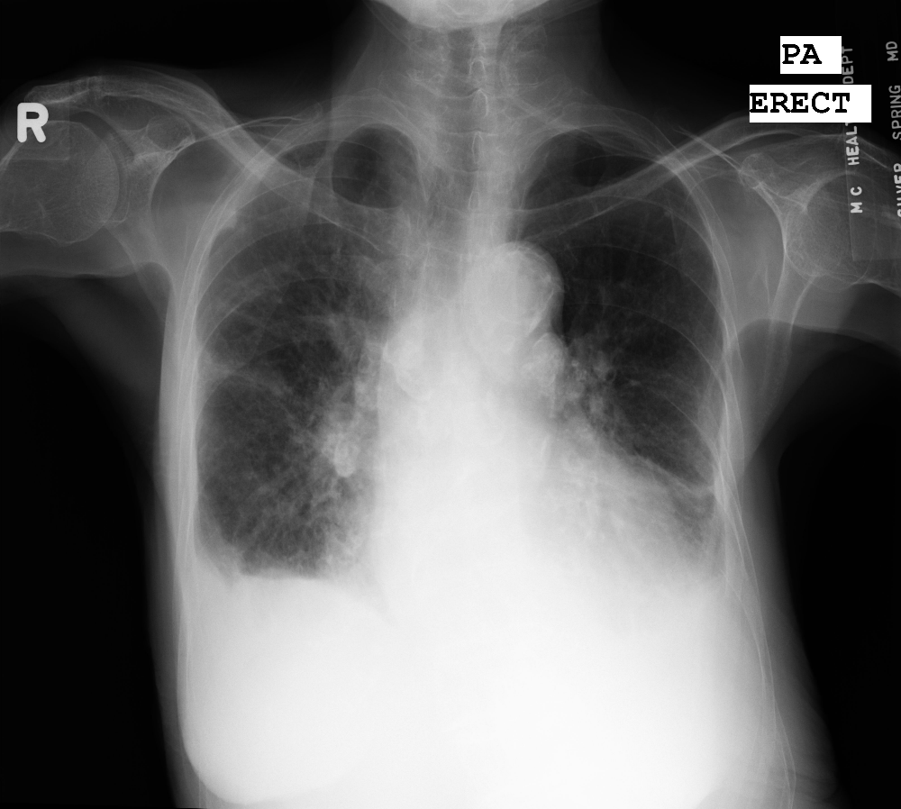
Dataset
Source: X-ray images were obtained from the tuberculosis control program of the Department of Health and Human Services, Montgomery County, MD, USA.
Total Images: The dataset consists of 138 posterior-anterior X-rays.
Normal Cases: 80 X-rays in the dataset are normal.
Abnormal Cases: 58 X-rays show manifestations of tuberculosis.
Materials

Slide 7
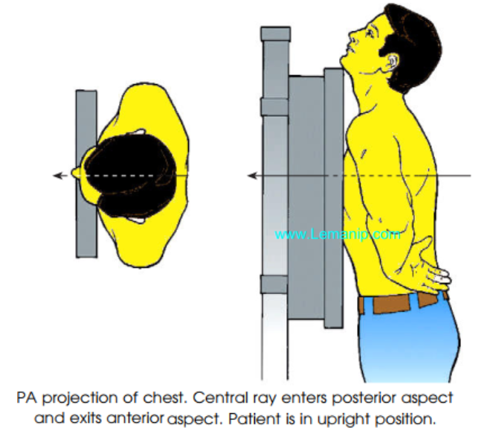
X-Ray Method
- Posterior Anterior projection
Materials

Slide 8
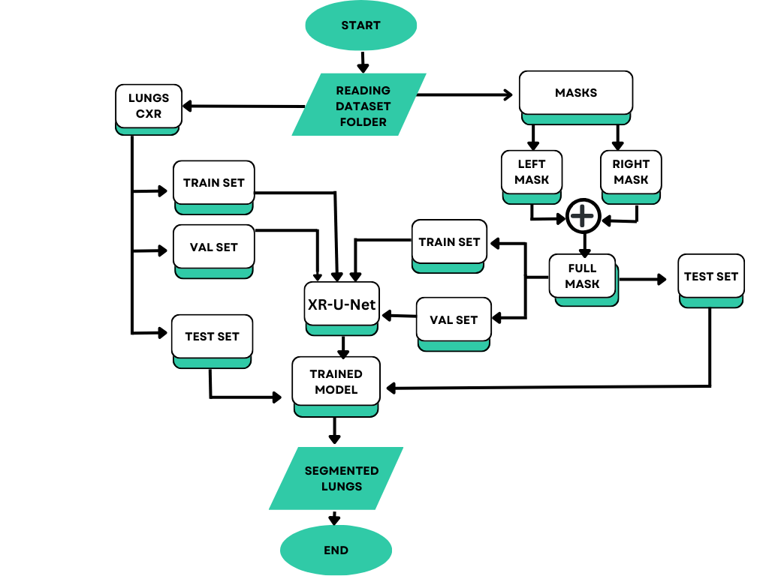
Workflow diagram
Materials

Slide 9
Dataset Spliting
- Train dataset contains 112 images.
- Validation dataset contains 13 images.
- Test dataset contains 13 images.
Materials

Slide 10
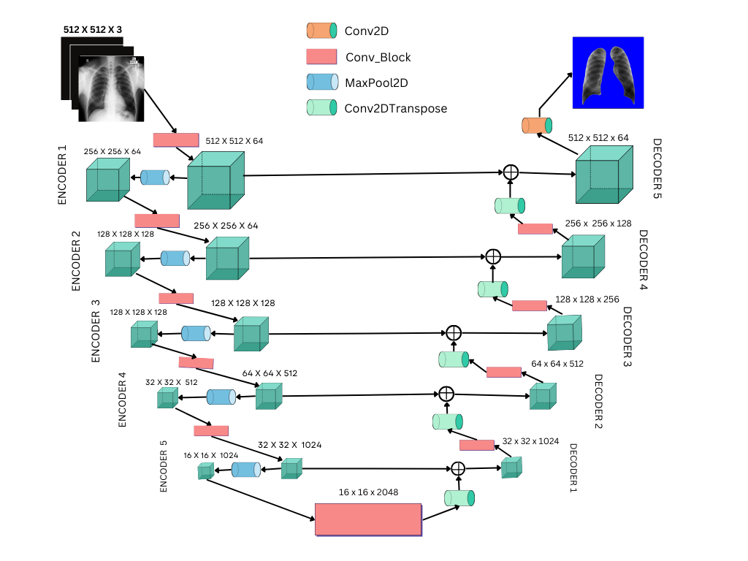
System Architecture
Methods

Slide 11
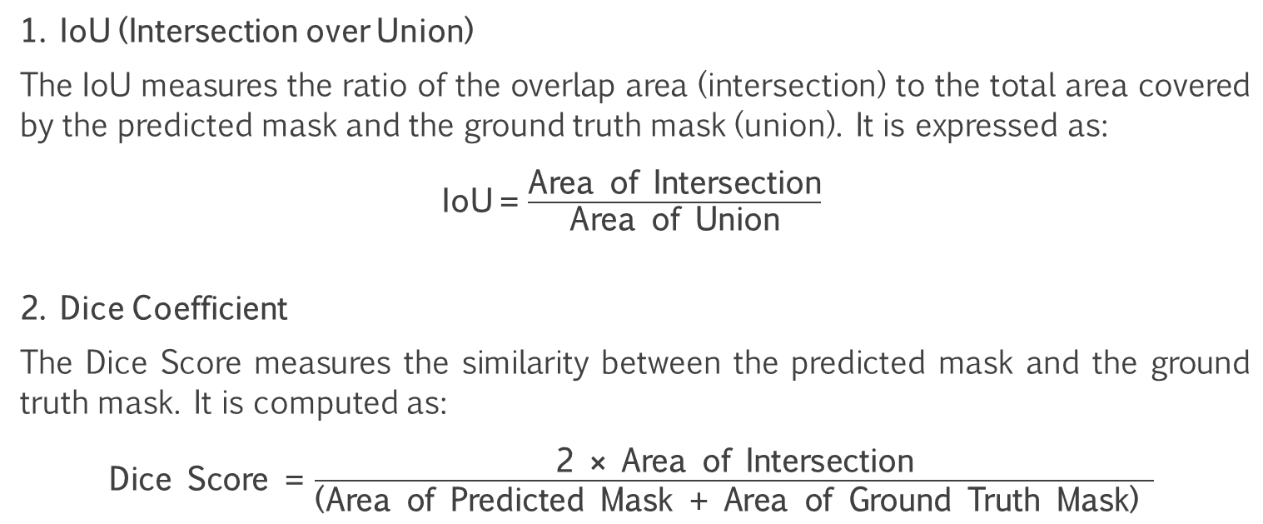
IoU and Dice Coefficient
1. IoU (Intersection over Union)
The IoU measures the ratio of the overlap area (intersection) to the total area covered by the predicted mask and the ground truth mask (union). It is expressed as:
IoU = $\frac{\text{Area} \text{of} \text{Intersection}}{\text{Area} \text{of} \text{Union}}$
2. Dice Coefficient
The Dice Score measures the similarity between the predicted mask and the ground truth mask. It is computed as:
$\text{Dice} \text{Score}\text{ =} \frac{\text{2 }\text{×} \text{Area} \text{of} \text{Intersection}}{\text{(}\text{Area} \text{of} \text{Predicted} \text{Mask}\text{ + }\text{Area} \text{of} \text{Ground} \text{Truth} \text{Mask}\text{)} }$
Methods

Slide 12
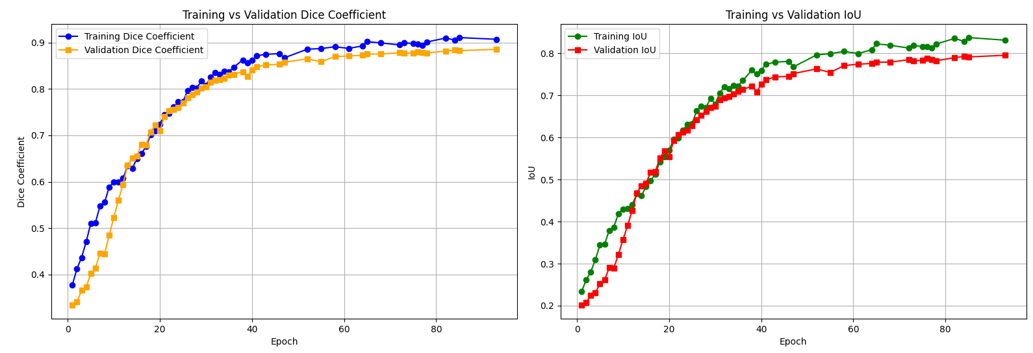
Training Curves
Figure 1: Training graph, the left side presents the training vs validation dice coefficient curve and the right side presents the training vs validation IoU graph.
Methods

Slide 13
Evaluation
(a)
(b)
(c)
Figure 2: Lung CXR images a) input image b) ground truth segment, and c) predicted segment
Results

Slide 14
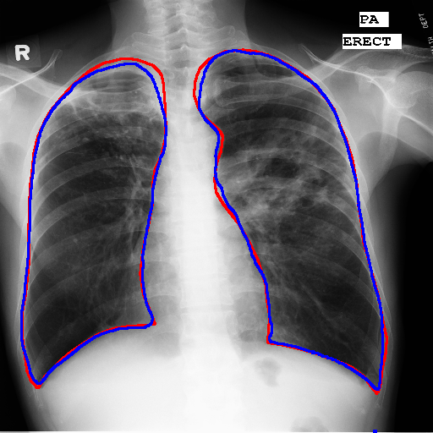
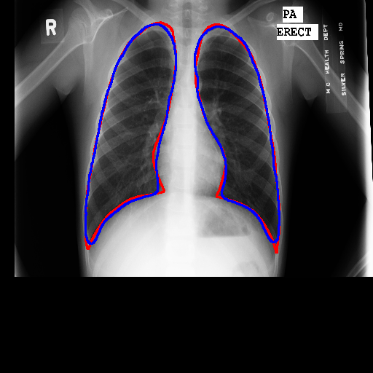
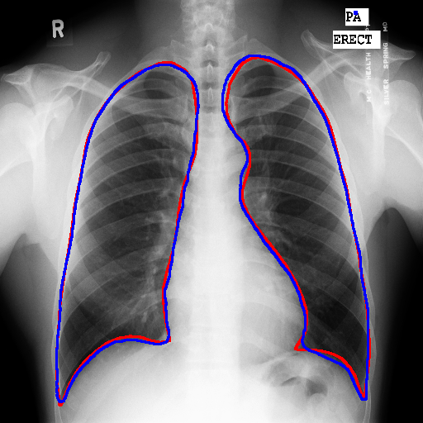
Evaluation
Figure 3: Comparison of segmentation results. The red border indicates the edges of ground truth mask, whereas the blue border indicates the edges of predicted mask.
Results

Slide 15
Comparative study
References | Methods | Dataset | Accuracy
Kumar et al. [1] | FCNN | JSRT | 97%
Boodi et al. [2] | U-Net | Custom | 98%
Pasa et al. [3] | CNN | Custom | 86.6 %
Mique et al. [4] | Deep Residual U-Net | Not specified | Not specified
Gite et al. [5] | U-Net++ | Montgomery County X-ray Set | 98 %
Proposed | XR-U-Net | Montgomery County X-ray Set | 95.7 %
Results

Slide 16
Limitations
Dataset lacks diversity, limiting model's generalizability.
Study focuses only on two-dimensional segmentation.
Minor discrepancies observed in intricate lung structures.
No integration with advanced diagnostic frameworks yet.
Discussion

Slide 17
Future Work
Incorporation of Larger and Diverse Datasets
Assessment of Heart Size
Detection of Cardiomegaly
Discussion

Slide 18
References
[1] P. Kumar, P. K. Soni, and L. Raja, "Enhanced Lung Segmentation from Chest X-Ray Images using Attention Based FCNN," International Journal of Intelligent Systems and Applications in Engineering, vol. 12, no. 3, pp. 437–444, 2024.
[2] D. Boodi, N. Sudheer, A. P. Bidargaddi, S. Shatagar, and M. Telkar, "Semantic Segmentation of Computed Tomography Scan of Lungs," 2024 5th International Conference for Emerging Technology (INCET), Belgaum, India, 2024, pp. 1-7, doi:10.1109/INCET61516.2024.10593534.
[3] F. Pasa et al., "Efficient Deep Network Architectures for Fast Chest XRay Tuberculosis Screening and Visualization," Scientific Reports, vol. 9, no. 1, p. 6268, Apr. 2019. doi: 10.1038/s41598-019-42557-4.
[4] E. Mique and A. Malicdem, "Deep Residual U-Net Based Lung Image Segmentation for Lung Disease Detection," IOP Conference Series: Materials Science and Engineering, vol. 803, no. 1, p. 012004, Apr. 2020. doi: 10.1088/1757-899X/803/1/012004.
[5] S. Gite, A. Mishra, and K. Kotecha, "Enhanced lung image segmentation using deep learning," Neural Computing and Applications, vol. 35, pp. 22839–22853, 2023. doi: 10.1007/s00521- 021-06719-8

Slide 19


